Slide 1

Solar Power Plant Design

Slide 2
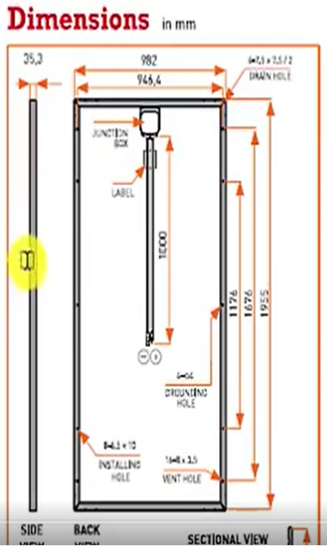
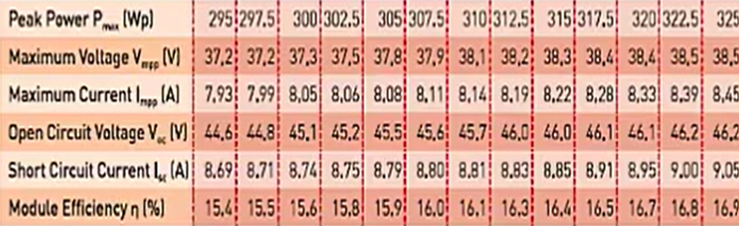
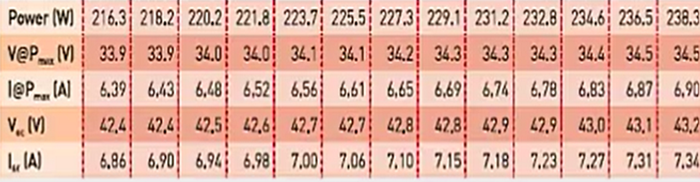
This Datasheet is applicable for: ELDORA VSP.72.AAA.03(AAA=295-325)
Electrical Data1
Electrical Parameters at NOCT2

Slide 3
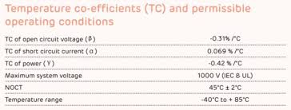
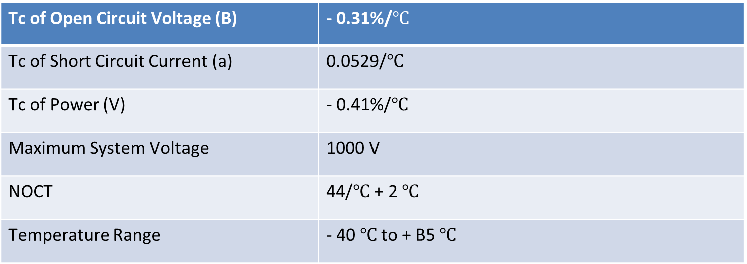
Temperature Coefficients (Tc) permissible operating-conditions
Tc of Open Circuit Voltage (B) | - 0.31%/$℃$
Tc of Short Circuit Current (a) | 0.0529/$℃$
Tc of Power (V) | - 0.41%/$℃$
Maximum System Voltage | 1000 V
NOCT | 44/$℃$ + 2 $℃$
Temperature Range | - 40 $℃$ to + B5 $℃$

Slide 4
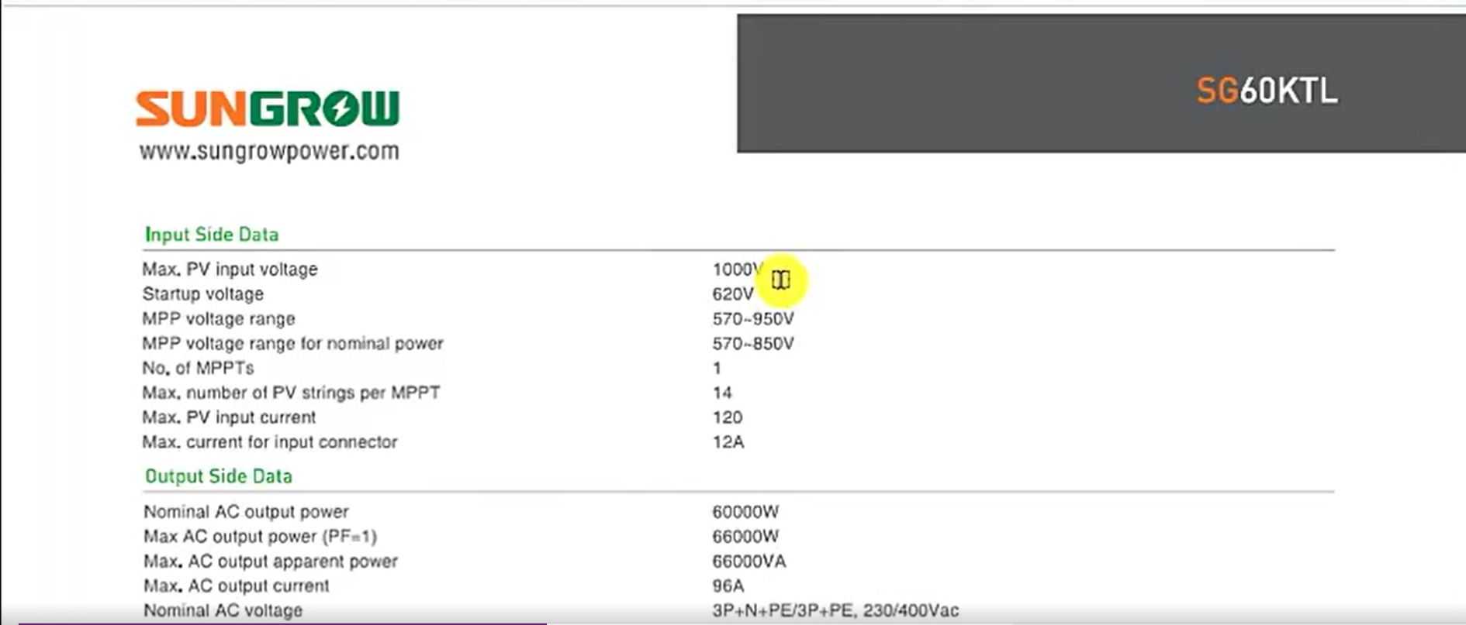

Slide 5
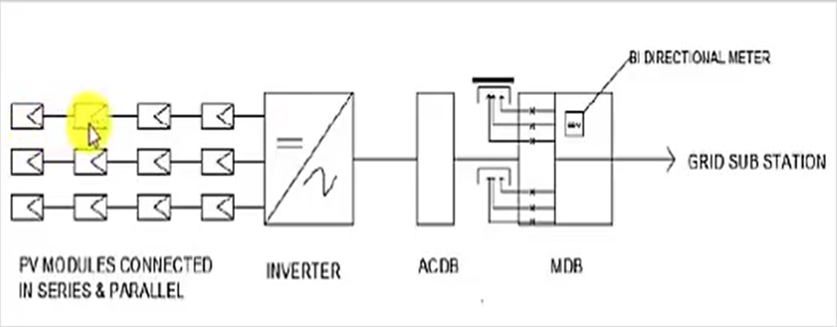

Slide 6
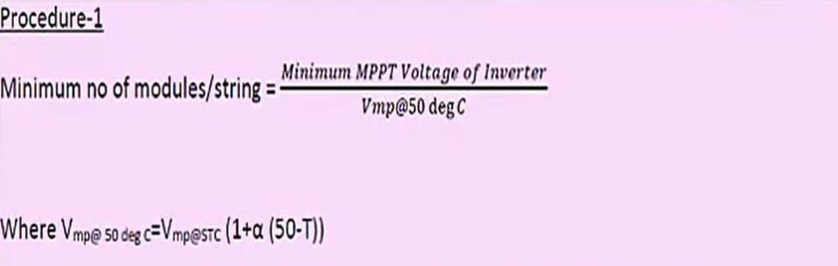
Selection of no of modules/string
Procedure-I: Based on MPPT
Procedure-2: Based on the allowable voltage rating

Slide 7
Procedure - I
Minimum no of modules/string = Minimum MPPT Voltage of Inverter
Vmp@50 deg c
Where Vmp@50 deg c=Vmp@STC (1+a (50-T))
Here, a is the temperature co-efficient for voltage & is available in Module datasheet.
Maximum no of modules/string = Maximum MPPT Voltage of Inverter
Vmp@O deg C
Where Vmp@ o degc=Vmp@stc (1+a (O-T))

Slide 8
Procedure - 2
Minimum no of modules/string = Minimum MPPT Voltage of Inverter
voc@50 deg C
Maximum no of modules/string = Maximum PV input Voltage
voc@0 deg c

Slide 9
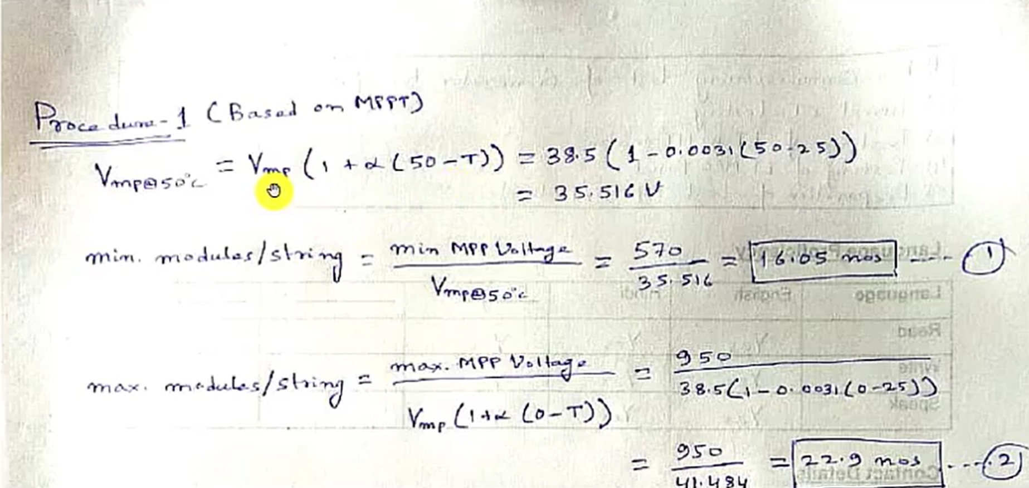

Slide 10
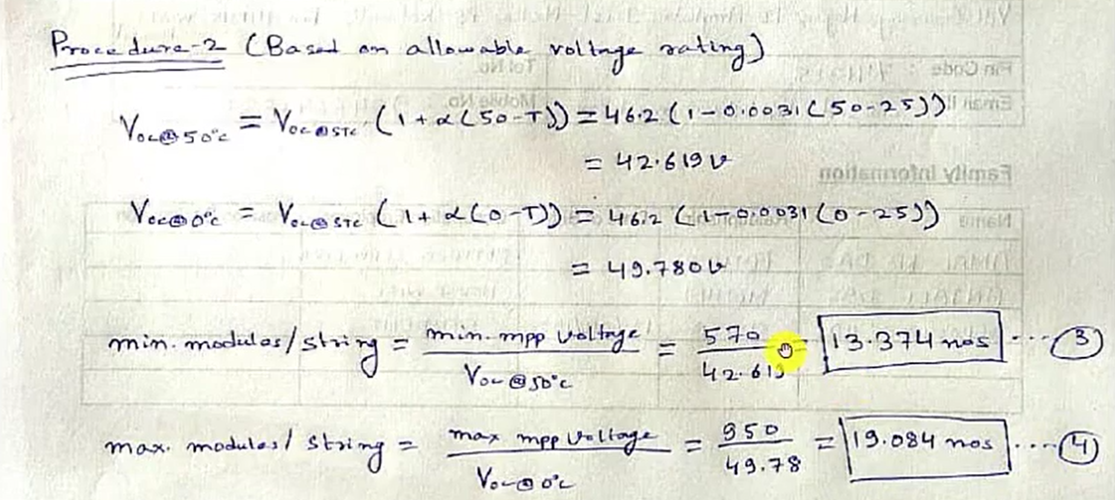

Slide 11
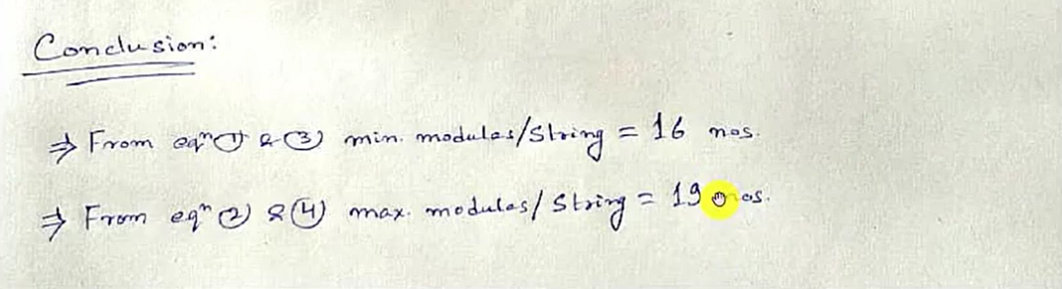

Slide 12
Thank You

